Slide 1
Digital Communication
Matched Filter
Dr. M. Venu Gopala Rao
A.M.I.E.T.E, M.Tech, Ph.D(Engg)
Cert. in R.S.T ( City & Guild’s London Institute, London)
F.I.E.T.E, L.M.I.S.T.E, I.S.O.I., S.S.I., M.I.A.E.
Professor, Dept. of ECE, K L University
mvgr03@kluniversity.in

Slide 2
Baseband Pulse Transmission Matched Filter
The term base-band is used to designate the band of frequencies representing the original signal delivered by a source of information

Slide 3
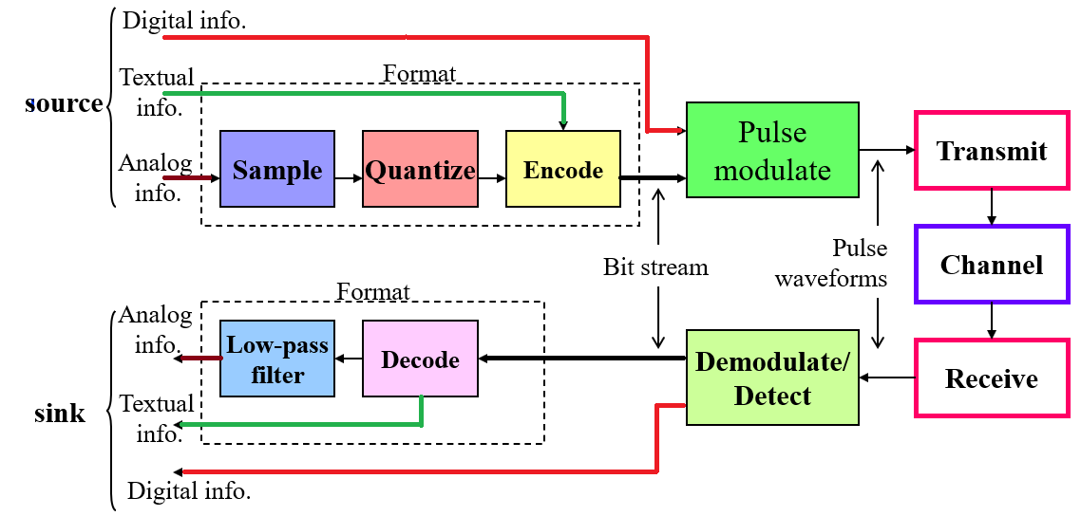

Slide 4
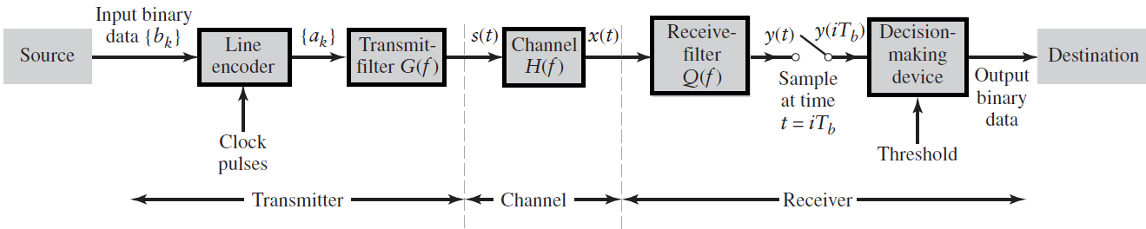
Binary Base-band data transmission System
The term base-band is used to designate the band of frequencies representing the original signal delivered by a source of information

Slide 5
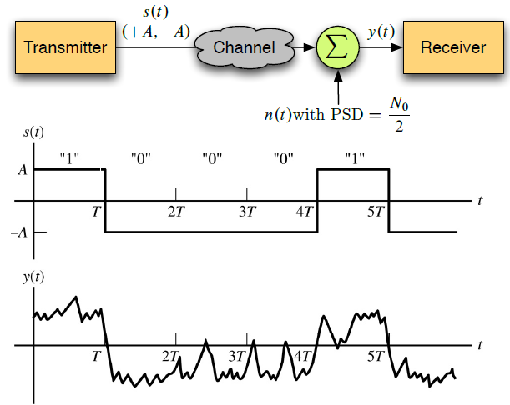
Block diagram of a baseband binary transceiver

Slide 6

Introduction to Matched Filter
The transmission of digital data over a baseband channel is affected by channel noise as illustrated below:
A basic problem that often arises in the study of communication systems is that of detecting a pulse transmitted over a channel that is corrupted by channel noise.
A device (an LTI filter) for optimum detection of a pulse corrupted by noise in the channel is referred to as Matched filter.
i.e.,the impulse response of the Matched filter is matched to the pulse signal.

Slide 7
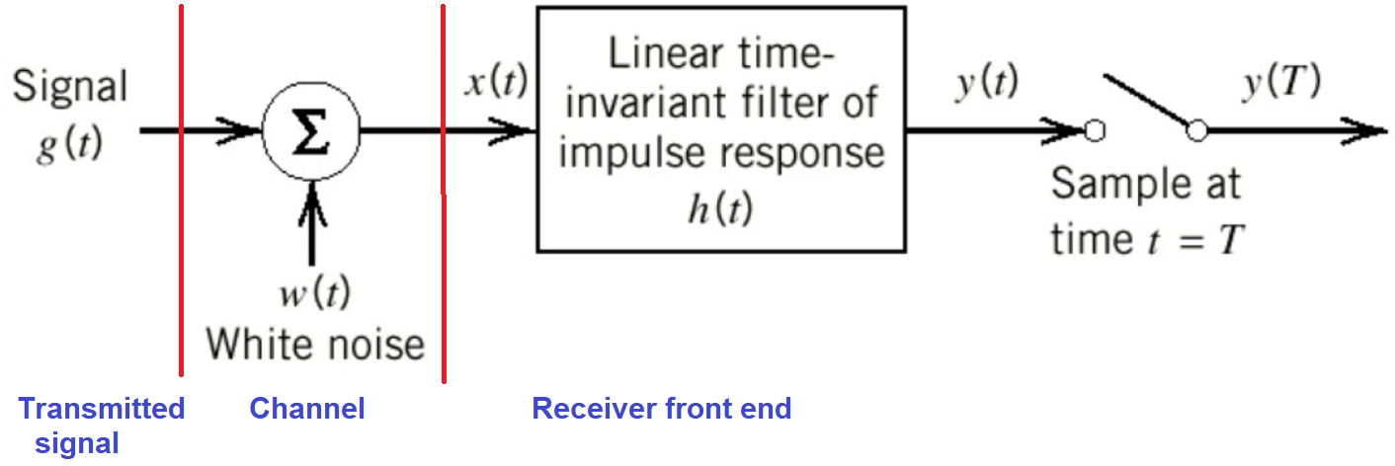
Matched Filter
A matched filter is a linear filter designed to provide the maximum signal-to-noise power ratio at its output. This is very often used at the receiver.
Receiver Model

Slide 8
Consider that the filter input x(t) consists of a pulse signal g(t) corrupted by additive noise w(t) .
It is assumed that the receiver has knowledge of the waveform of the pulse signal g(t).
The source of uncertainty lies in the noise w(t).
The function of receiver is to detect the pulse signal g(t) in an optimum manner, given the received signal x(t).
The purpose of the circuit is to design an impulse response h(t) of the filter such that the output signal-to-noise ratio is maximized.

Slide 9


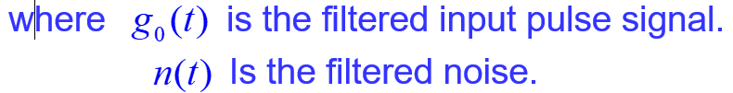

Slide 10
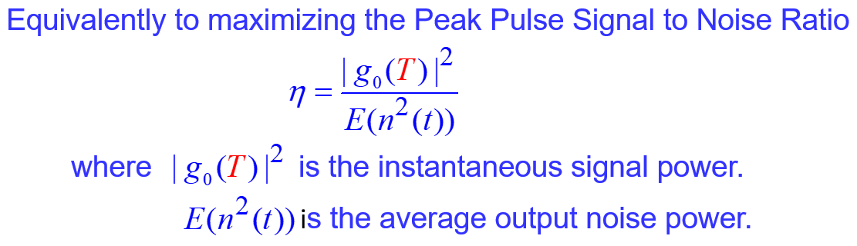

Slide 11
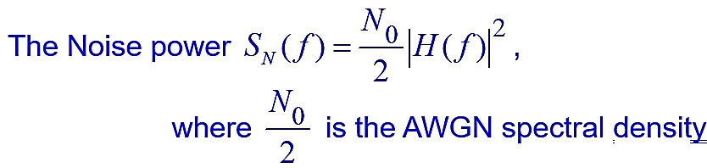
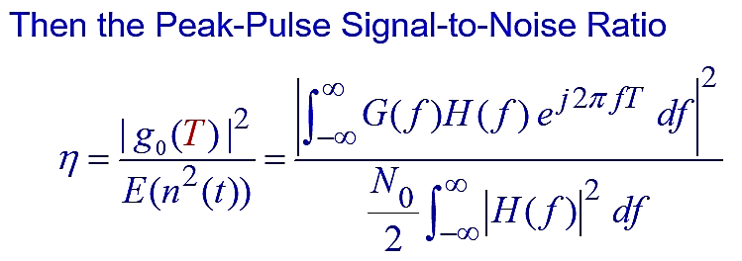
AWGN: Additive White Gaussian Noise
Additive white Gaussian noise (AWGN) is a basic noise model used in information theory to mimic the effect of many random processes that occur in nature.
Additive because it is added to any noise that might be intrinsic to the information system.
White refers to the idea that it has uniform power spectral density across the frequency band for the information system. It is an analogy to the color white which may be realized by uniform emissions at all frequencies in the visible spectrum.
Gaussian because it has a normal distribution in the time domain with an average time domain value of zero (Gaussian process).

Slide 12
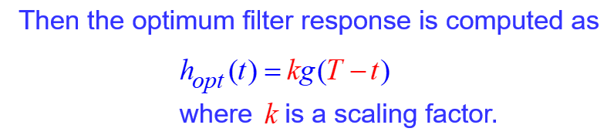

Slide 13
Properties of Matched Filter
Property1. A filter matched to a pulse signal g(t) of duration T is characterized by an impulse response that is time-reversed and delayed version of the input g(t):
Property2. A matched filter is uniquely defined by the waveform of the pulse but for the:
- time delay T
- Scaling factor k
Property3: The peak signal-to-noise ratio of the matched filter depends only on the ratio of the signal energy to the power spectral density of the white noise at the filter input.

Slide 14
End

